Slide 1

Appium
www.pragmatic.bg
Lector: Dimitar Topuzov
E-mail: dtopuzov@gmail.com
LinkedIn: http://bg.linkedin.com/pub/dimitar-topuzov/18/470/833/en
Copyright © Pragmatic LLC 2018

Slide 2
Content
General Theory
What is Appium?
History
Appium Philosophy and Design
Packages
Issues
Desktop App
Usage
Capabilities
Demos

Slide 3
Appium
How I explained what is Appium in 2015
Appium is an open-source tool for automating native, mobile web, and hybrid applications on iOS and Android platforms
How I can explain Appium now
The ultimate open-source automation for anything

Slide 4
Appium History
www.pragmatic.bg

Slide 5

The Father
Dan Cuellar

Slide 6
The Beginning
Back in 2012, Dan Cuellar had a problems with iOS Automation
At this time Apple had UIAutomation which can control iOS Simulator/Device with JavaScript commands
He prepared code in C# that implemented the Selenium-style syntax to write the sequentially ordered JavaScript commands
Demo was done on Selenium Conference 2012
Dan’s product was called “iOS Auto”

Slide 7

The Godfather
Jason Huggins

Slide 8
…a bit offtopic
Who is Hug?
Jason Huggins is the original author of Selenium
Helped in kick start of Appium project
Supported the "Selenium Farm" @Google
Co-founder and CTO at Sauce Labs
Founder of Tapster Robotics

Slide 9
The Beginning
Several months after Selenium Conference 2012 the phone rings
Jason Huggins, co-creator of Selenium called Dan and convinced him to open source “iOS Auto”
Then Jason convinced Dan to rewrite it in some language that will be more comfortable for open source community and “iOS Auto” was implemented on Python
In September, Jason added a web server and began to implement the WebDriver wire protocol over HTTP, making iOS Auto scriptable from any Selenium WebDriver client library in any language.

Slide 10
Sauce Labs
In January 2013 Sauce Labs decided to fully back Appium and provide more developer power
Jonathan Lipps (the current project lead) was involved
JavaScript and NodeJS were selected and development started
Few months later Android support was released, making Appium the first truly cross-platform automation framework.

Slide 11

The Babysitter
Jonathan Lipps

Slide 12
Appium 1.0 – 1.6
Appium 1.0 - May 2014
First official version
Appium 1.3 - Oct 2014
iOS 8 Support
Appium 1.4 - May 2015
iOS 9 support in appium@1.4.9
Appium 1.5 - Feb 2016
The Re-Write, split into various smaller modules
Appium 1.6 - Oct 2016
iOS 10 support (migrated to XCTest)
Windows Desktop support

Slide 13
Appium – Today
Appium 1.7.0 – Sep 2017
Support iOS 11
Support multiple simultaneous sessions
Latest official version: 1.7.2 - Jan 3
Latest beta version: 1.8.0-beta3 - March 27
1.8 will be based on W3C WebDriver Spec
Sauce Labs Donates Appium Copyright to JS Foundation
Appium is now officially owned by the community, not by Sauce Labs
…not sure I’m happy ☺ ☹ …we will see…

Slide 14
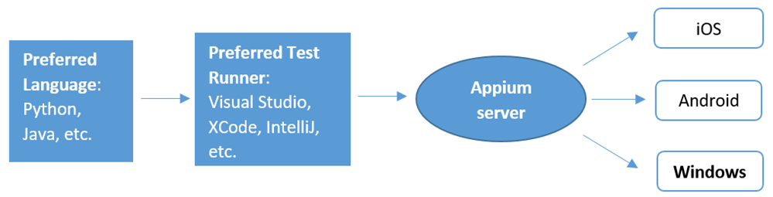
Appium – Today

Slide 15

Appium – The Future

Slide 16
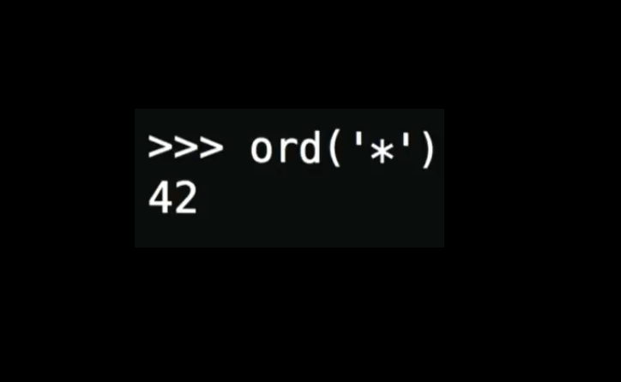
Appium – The Future

Slide 17
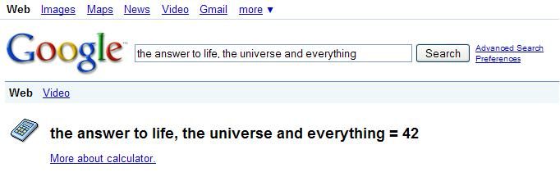
Appium – The Future

Slide 18

Appium – The Future
March 2, 1976

Slide 19

Appium – The Future
2018 – 1976 = 42

Slide 20

Appium – The Future
42 =

Slide 21
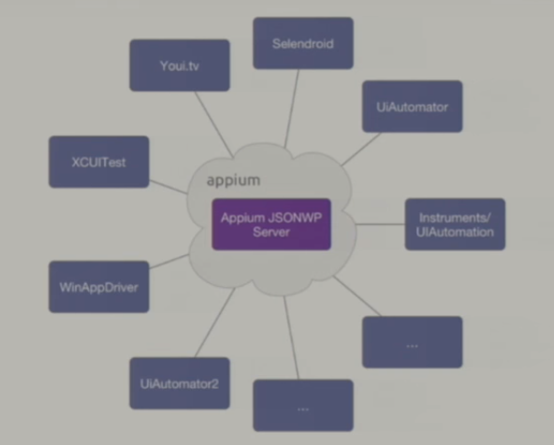
Appium – Future
* Driver

Slide 22
Appium Philosophy and Design
www.pragmatic.bg

Slide 23
Appium Philosophy
You shouldn't have to recompile your app or modify it in any way in order to automate it.
You shouldn't be locked into a specific language or framework to write and run your tests.
A mobile automation framework shouldn't reinvent the wheel when it comes to automation APIs.
A mobile automation framework should be open source, in spirit and practice as well as in name!

Slide 24
Appium Design
You shouldn't have to recompile your app or modify it in any way in order to automate it.
Achieved by using vendor-provided automation frameworks under the hood
iOS 7,8,9: Apple's UIAutomation
iOS 10+: Apple’s XCTest
Android 4.3+: Google's UiAutomator
UiAutomator2 based Appium driver under development
Android 2.3+: Google's Instrumentation.
Instrumentation support is provided by bundling a separate project, Selendroid

Slide 25
Appium Design
You shouldn't be locked into a specific language or framework to write and run your tests.
Achieved by wrapping the vendor-provided frameworks in one API, the WebDriver API
WebDriver (aka "Selenium WebDriver") specifies a client-server protocol (known as the JSON Wire Protocol)
Client-server architecture benefits
A client written in any language can be used to send the appropriate HTTP requests
There are already clients written in every popular programming language
We can put the server on a different machine than our tests are running on
We can write test code and rely on a cloud service like Sauce Labs to receive and interpret the commands.

Slide 26
Appium Design
A mobile automation framework shouldn't reinvent the wheel when it comes to automation APIs.
Achieved by reusing WebDriver and JSON Wire Protocol
And extended the protocol with extra API methods useful for mobile automation
Achieved by reusing vendor-provided automation frameworks

Slide 27
Appium Design
A mobile automation framework should be open source, in spirit and practice as well as in name.
Appium Server
~7K Stars and ~3K Forks on GitHub
Most of client bindings are also in Appium organization
Issues
Sample code
Website and Forum

Slide 28
Appium Requirements and Packages
www.pragmatic.bg

Slide 29
Appium Requirements
General
Your environment needs to be setup for the particular mobile platforms
See next slides for particular platform requirements
Node.js
Node 6 or above (preferably latest LTS release)
Windows: Use the installer
Linux: Use Node Version Manager
OSX: Use brew
Make sure you have not installed Node or Appium with sudo!

Slide 30
Appium Requirements
Android
Android SDK
Install the SDK
Set ANDROID_HOME to be your Android SDK path
Add the tools and platform-tools folders to your PATH variable
Install all APIs (SDK + Emulator Images) you want to automate via SDK Manager
Appium supports Android on macOS, Linux and Windows
Linux
Osx
Windows

Slide 31
Appium Requirements
iOS
macOS (latest stable recommended)
XCode (latest stable recommended)
Multiple Xcodes on same machine can be installed, but only one can be active (use xcde-select command).
iPhone simulator SDKs
By default latest Xcode has only latest iOS SDKs
You can install additional SDKs via Xcode
Enable UIAutomation on iOS8+ devices
Settings -> Developer -> Verify that UIAutomaion is enabled

Slide 32
Appium Packages
Appium Server
Appium is a server written in Node.js
It can be built and installed from source or installed directly from NPM:
$ npm install -g appium
$ appium

Slide 33
Appium Packages
Appium Clients
There are client libraries which support Appium's extensions to the WebDriver protocol
Language/Framework | Github Repo and Installation Instructions
Ruby | https://github.com/appium/ruby_lib
Python | https://github.com/appium/python-client
Java | https://github.com/appium/java-client
JavaScript (Node.js) | https://github.com/admc/wd
C# (.NET) | https://github.com/appium/appium-dotnet-driver

Slide 34
Appium Packages
Appium Desktop
Desktop app for macOS, Linux and Windows
Include everything bundled, so don't worry about Node
Inspector enables you to check the hierarchy of apps
Recorder that can generate code in Java, Python, Ruby and JS
Downloads:
https://github.com/appium/appium-desktop/releases

Slide 35
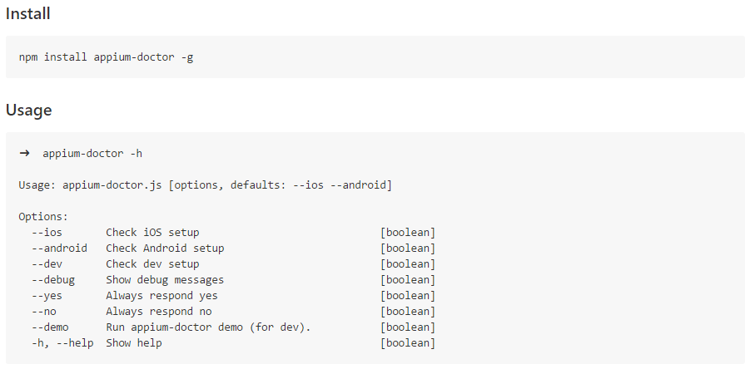
Troubleshooting
appium-doctor
troubleshooting.md

Slide 36
Appium Random Extras
www.pragmatic.bg

Slide 37
FindBy Image
Blog post
GitHub repo

Slide 38
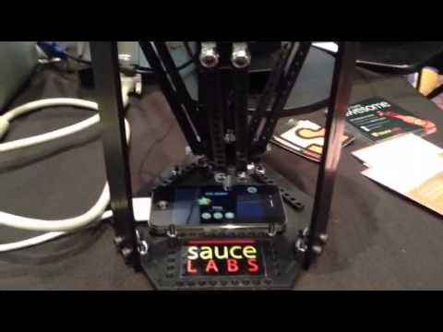
Tapster

Slide 39
Tapster
Official
https://www.tapster.io/
https://github.com/tapsterbot/tapsterbot
Tutorial
Tutorial by Dan Cuellar

Slide 40
Appium Issues
www.pragmatic.bg

Slide 41
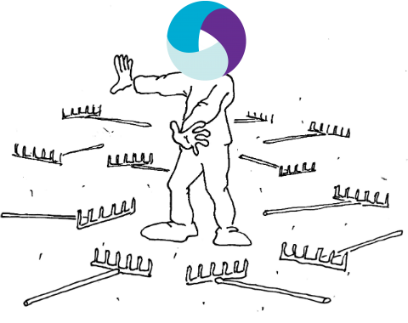

Slide 42


Slide 43
Issues
…be prepared for a lot of issues on each release of
Appium
Npm
Native platforms automation
iOS or Xcode
Android OS or Android Tools

Slide 44
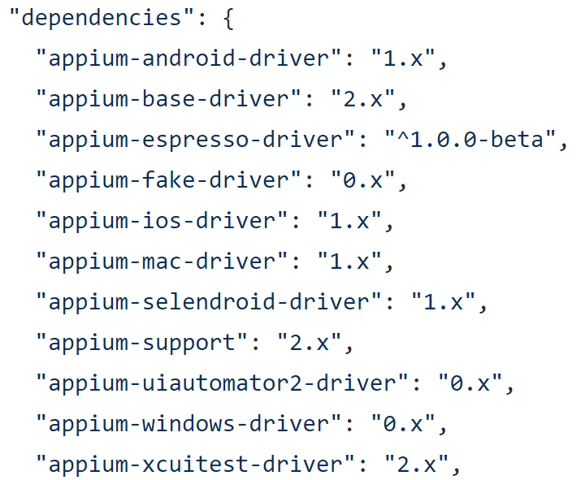
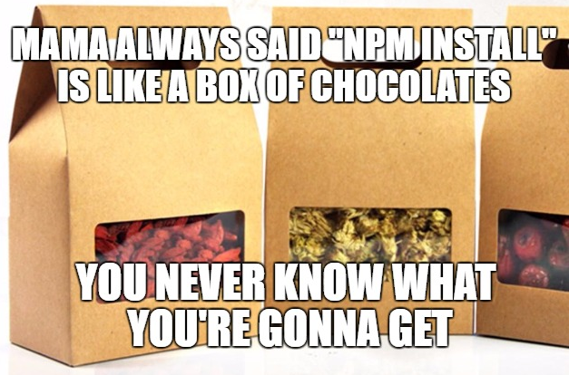
Npm Issues

Slide 45
Npm Issue Example
Appium 1.6.0-beta2 use ^ for npm dependencies
Appium depends on appium-android-driver
appium-android-driver depends on appium-adb
appium-adb released a patch to fix issue with Android 7 and totally broke installation of apps or Android 4.* and 5.*

Slide 46
Npm Issue Example
Result:
It works on my machine, it works on some machines on CI, it fails on other machines
Appium version is same, but it is install on different date and on some machines it use appium-adb@2.1.3 on some machines it users appium-adb@2.1.5
Moreover
When app fails to install, appium reports “fail to start activity” error -> you think app crash at start up -> you get the app -> it works when you test it manually -> WFT? -> Actually it fails to start activity because app is not deployed ☺
Wish you happy debugging ☺

Slide 47
Native Platform Issues
Native automation technology changes
Gestures not working (specially on iOS)
Finding elements works a bit different
UI becomes different
Not only as UI, but also elements are different types
Emulator/Simulator/Device changes
Usually to work with latest iOS version you also need to install latest Xcode

Slide 48
Solutions
No solutions for something that we can’t predict ☺
What will help you to solve issues:
Ask Google ☺
Watch commits in Appium repos (or at lest read changelogs of releases)
Learn
Android and iOS native tools
macOS
Shell scripting
Npm, NodeJS and JavaScript
How to better use Google search

Slide 49

Questions

Slide 50
Appium Desktop Usage
www.pragmatic.bg

Slide 51
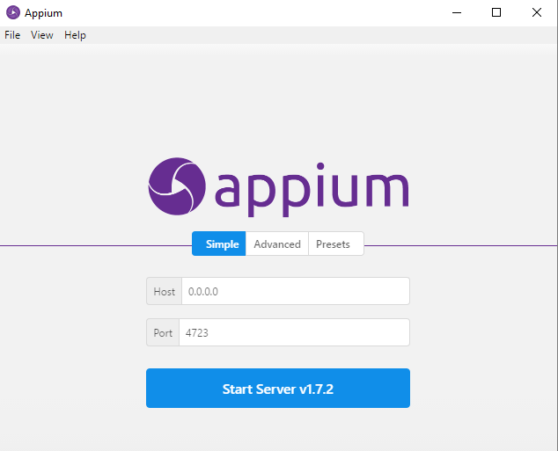
Start Local Server

Slide 52
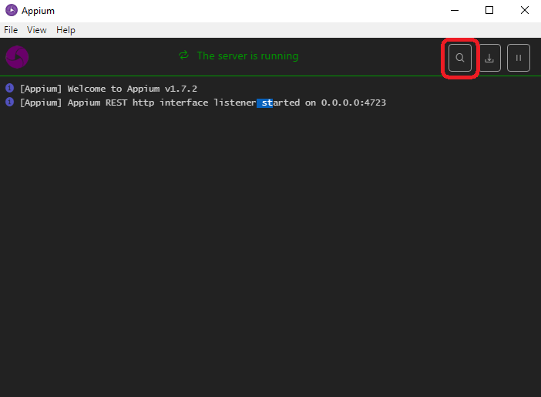
Start Inspector

Slide 53
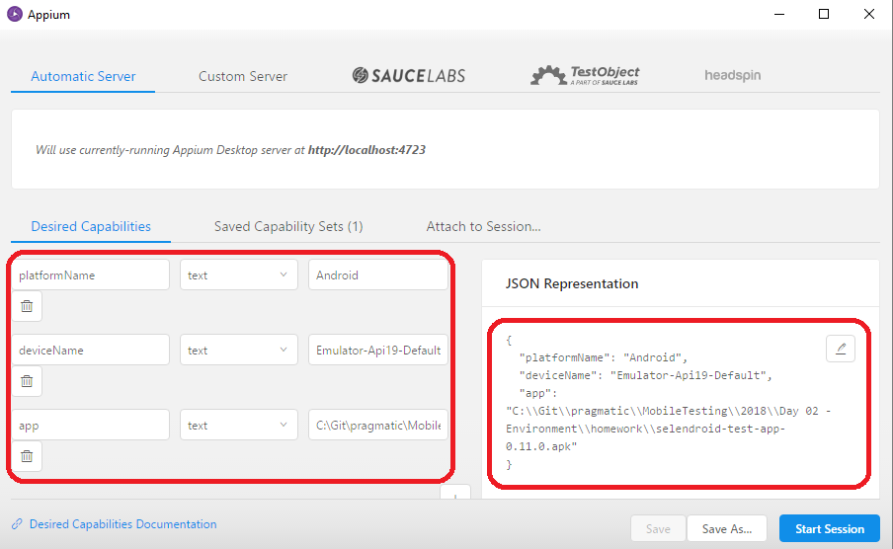
Capabilities

Slide 54
Capabilities
Start new session
Run manually Android emulator
Specify those capabilities and hit “Start Session” button
{
"platformName": "Android",
"deviceName": "Emulator-Api19-Default",
"app": "C:\\<path>\\selendroid-test-app-0.11.0.apk"
}

Slide 55
Capabilities
platformName
Mandatory
iOS, Android, FirefoxOS, Windows
platformVersion
Optional (if set it is verified)
Example: 8.1, 11.3
automationName
Optional
Which automation engine to use
Appium (default), Selendroid, UiAutomator2, Espresso, XCUITest, YouiEngine

Slide 56
Capabilities
deviceName
Mandatory
For Android it can be random value
For iOS it must be one of the valid devices returned by instruments with instruments -s devices.
app
The absolute local path or remote http URL to an .ipa or .apk file, or a .zip containing one of these.
Not required for Android if you specify appPackage and appActivity capabilities (see below).
Incompatible with browserName.

Slide 57
Capabilities
browserName
Specify only for Web tests
'Safari' , 'Chrome', 'Chromium' or 'Browser‘
udid
Unique device identifier of the connected physical device
e.g. 1ae203187fc012g
orientation
Emulator and Simulator only
LANDSCAPE or PORTRAIT

Slide 58
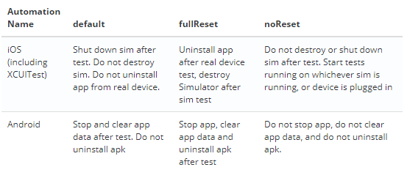
Capabilities
noReset and fullReset

Slide 59
Android Capabilities
appPackage
Package ID of the Android
Example: org.nativescript.TestApp
appActivity
Activity name for the Android activity you want to launch from your package
Example: MainActivity
appWaitPackage and appWaitActivity
Package and activity you want to wait until it start
Appium session will fail if activity do not start

Slide 60
Android Capabilities
avd
Name of emulator you want to auto launch
avdArgs
Arguments that you can pass on avd start
avdLaunchTimeout
How long to wait in milliseconds for an avd to launch and connect to ADB
avdReadyTimeout
How long to wait in milliseconds for an avd to finish its boot animations

Slide 61
Demo Time
Inspector
Find Elements
Recorder
Gestures on coordinates
Click Element and SendKeys

Slide 62
Questions

